Slide 1
Nerd Herd 687
Programming Curriculum
Robot Code Structure

Slide 2
Command Based Framework
We program in Java using WPILib’s Command Based Framework
Official FRC languages - C++, LabVIEW, Java
Unofficial languages - Python, Kotlin
If we use a unofficial language we may not get help from CSAs and FTAs at competition, if we need help
Advantages of Command-Based
Relatively easy to do simultaneous actions
Raise arm while driving forwards
Easily make modular auto routines
https://wpilib.screenstepslive.com/s/currentCS/m/java/l/599732-what-is-command-based-programming

Slide 3
Main Parts of a Command Based Robot
Robot.java
Your main robot file. The init and periodic functions here are called by the driver station during a match
OI
The operator interface. All joysticks and buttons are here.
RobotMap
All port numbers for motors and double solenoids are kept here, for convenience
Subsystems
Physical subsystems on the robot, such as an arm or an intake
Commands
Tasks the robot does, such as driving forward x feet, or raising its arm to x degrees
Command Groups
Groups of multiple commands which can be run sequentially or in parallel. One example is driving 10 feet forwards and then raising the robot’s arm to 60 degrees

Slide 4
RobotMap
RobotMap contains port numbers for motors and double solenoids (used to control pistons).
All port numbers are kept in one place to make it easier to change port numbers
Conventions for port numbers is:
public static final int kName#ID = [Port Number]
Public: can be used in any file
Static: there is only one of this constant
Final: the port number can’t be changed from code
Int: port numbers are integers

Slide 5
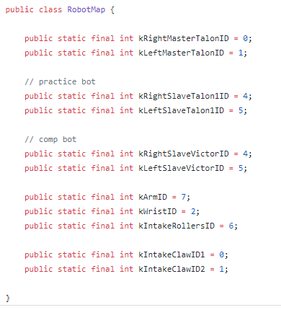
RobotMap Examples

Slide 6
Motor Controllers
When you control a motor in code, you’re not directly controlling the motor, you’re controlling the motor controller, which then sends the desired voltage to the motor
A motor controller can be plugged into more or less any motor, so we don’t need to change too much code if mech decides to change motors
Motor controllers can handle stuff that we’d need code to do otherwise
Current limiting, PID, motion profiling
Common Motor Controllers (on 687):
Talon SRX, Victor SPX, VictorSP

Slide 7
Motor Controllers (2)
Talon SRX: The best and most expensive motor controllers available for FRC
Have fancy closed loop controls to set position and speed
Have a sensor input so an encoder can be directly connected
Good for drivetrain masters, arms, anything that needs its position or speed controlled
On Diplo, Cosmos, and Practicebot
CAN
Victor SPX: Less fancy but more affordable
No sensor input, no built in control loops
Good as drivetrain slaves, intakes, or anything that precision control isn’t needed on
On Diplo
CAN
Victor SP: Older motor controllers
PWM, only on older bots (COTS and Mantis)
Don’t have fancy built in control loops

Slide 8
Motor Controllers (3)
Motor Controllers have different control modes
Position, Velocity, Percent output
Percent output is simplest
Percent output is from a scale of -1.0 to 1.0
-1.0 ~ -12 V
1.0 ~ 12 V
More volts -> more speeds
Positive voltage is one direction, negative is the other
Too much current draw for too long will heat up the motor and possibly kill it

Slide 9
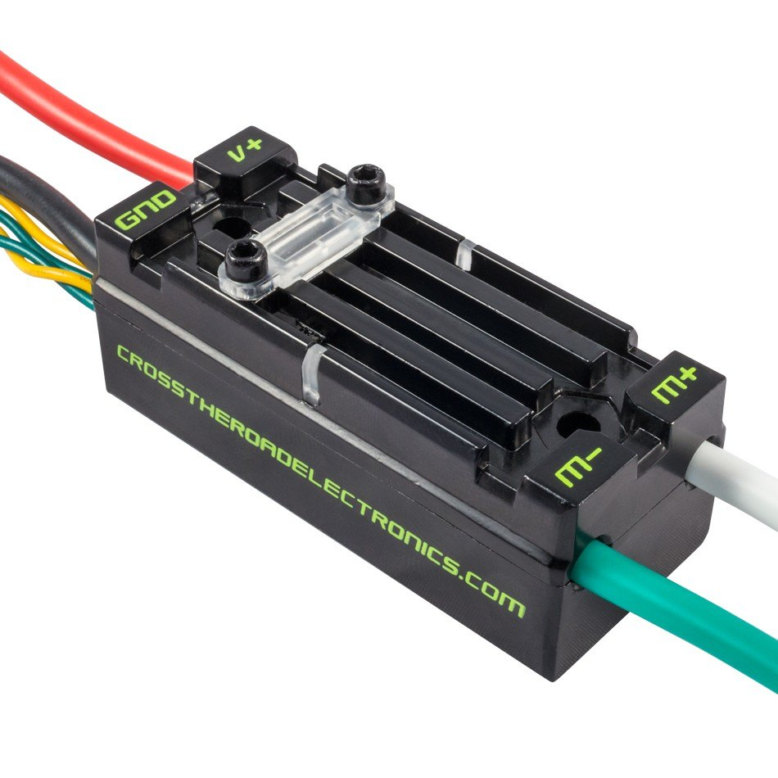
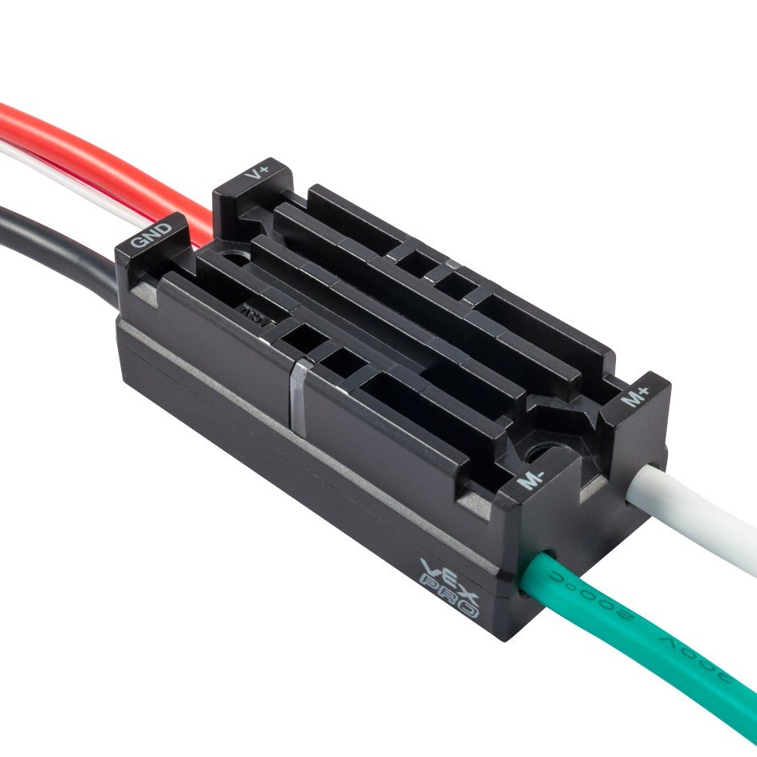
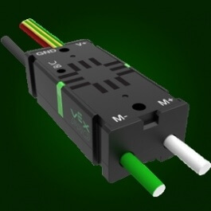
Motor Controllers (4)
Talon SRX
Victor SP
Victor SPX

Slide 10
Subsystems
Subsystems correspond to physical subsystems on the robot
Drivetrain, arm, intake, shooter, etc
Subsystems contain motors, pneumatics, and sensors on the robot that are used to control that subsystem
Subsystems should also have methods to receive sensor input and set power/voltages/positions/velocities to motor controllers
Use port numbers from RobotMap for motor controllers
Subsystems are initialized from Robot.java during robotInit

Slide 11
Robot.java
Robot.java has periodic and init functions
One periodic and one init for each possible robot mode
Periodic functions are called about every 20 ms by the driver station by default (the exact timing can be configured)
autonomousPeriodic, teleopPeriodic, disabledPeriodic, testPeriodic
Init functions are called when the robot mode changes (i.e. changing from autonomous to teleop makes the robot call teleopInit)
autonomousInit, teleopInit, disabledInit, testInit

Slide 12
Commands
Actions a subsystem or group of subsystems can take
Commands are created based on logic defined in subsystems and Robot.java
Various methods
initialize(): run just before the command starts to run
execute(): run in a loop while the command is running
isFinished(): if this returns true at any point, the command will stop running
end(): the method which is run when the command stops running
interrupted(): the method which is run when another command or other process stops the command
Commands can require a particular subsystem so that two commands do not attempt to use the same system and conflict with one another

Slide 13
References
https://www.vexrobotics.com/217-8080.html#Description
http://www.ctr-electronics.com/victor-spx.html
https://www.vexrobotics.com/217-9090.html
https://github.com/nerdherd/PowerUp2018

